Slide 1
DeKalb Farmers Market
RUCD 101 - User Experience Design, Spring 2020
Prepared By:
Benjamin Flamm
bflamm3@brandeis.edu
Prepared For:
David Lumerman (Professor)
dlumerman@brandeis.edu

Slide 2
Table of Contents
Project
Introduction
 | Introduces DeKalb Farmers Market, our team’s project and business objectives, as well as any barriers to success for redesigning their website. | Slide 3
 | Covers the overall research plan which includes: a heuristic evaluation, competitive analysis, user survey, target audience segmentation, and user persona generation | Slide 14
 | Contains links the proposed sitemap and navigation structure as well as wireframes for both desktop and mobile website versions
 | Includes usability testing plan and script with results from usability test that was conducted
 | Addresses unanswered questions, remaining steps to gain customer buy-in, and lessons learned
Research
User Experience
Design
Slide 24
Usability Testing
Slide 28
Conclusions
Slide 31

Slide 3
Project Introduction

Slide 4
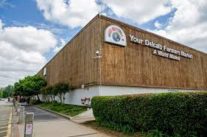
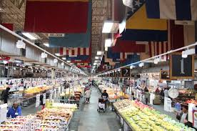
About DeKalb Farmers Market
140,000 sq. ft. facility located east of Atlanta, Georgia, in Decatur
Began in 1977 as a produce stand
Family-owned and operated
Vendor of in-house, local, and global products
DeKalb Farmers Market. [1]
Inner market. [2]
Notes:
References
[1] Decaturish.com. “Dear Decaturish – Your DeKalb Farmers Market and the Coronavirus.” Decaturish, 18 May 2020, decaturish.com/2020/05/dear-decaturish-your-dekalb-farmers-market-and-the-coronavirus/.
[2] “Seemingly Endless Fresh Produce beneath the Flags - Picture of Your Dekalb Farmers Market, Decatur.” Tripadvisor, www.tripadvisor.com/LocationPhotoDirectLink-g34895-d1171834-i294438412-Your_Dekalb_Farmers_Market-Decatur_Georgia.html.

Slide 5
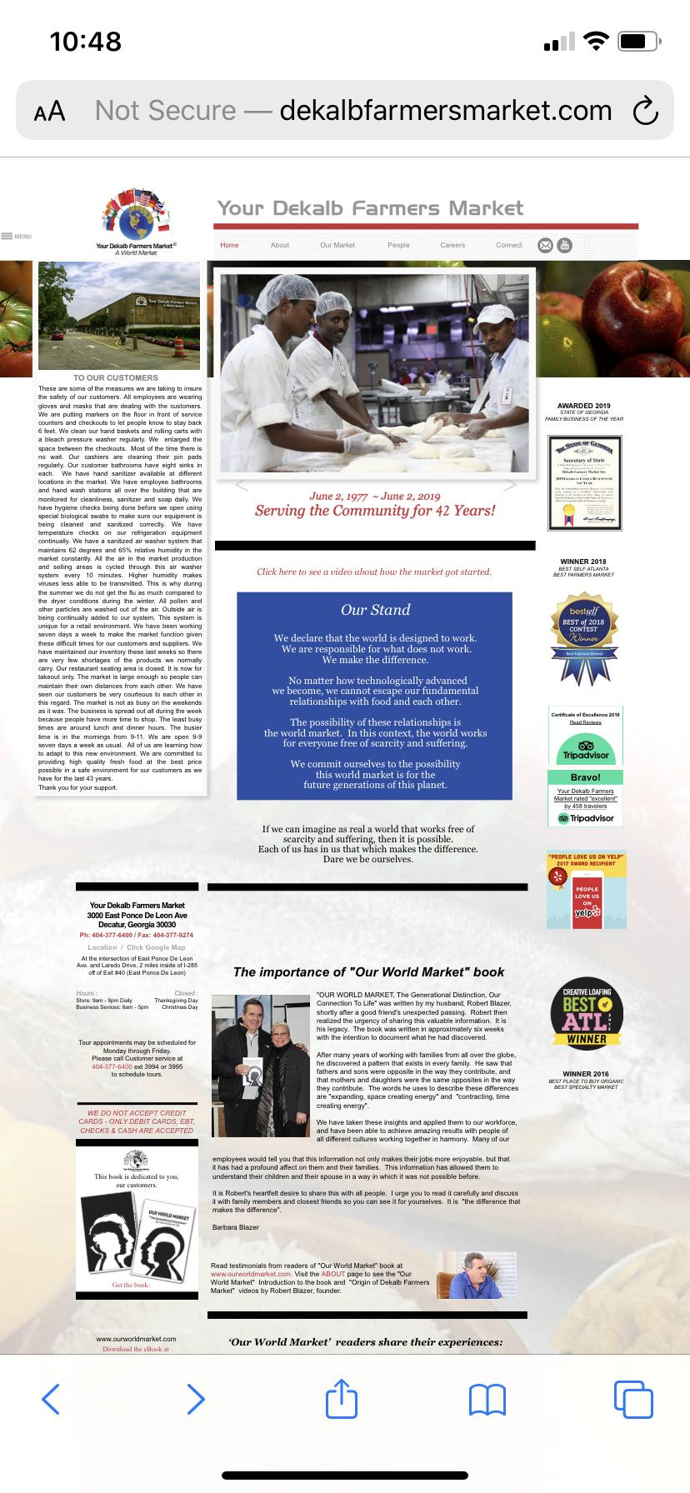
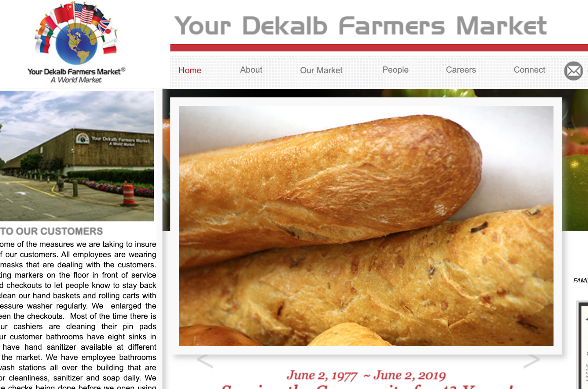
DeKalb Farmers Market Current Website
Designed in 2014
Minimal updates to images and content
Not optimized for mobile
Mobile version.
Desktop version. [3]
Notes:
References
[3] Home, www.dekalbfarmersmarket.com/index.html.

Slide 6
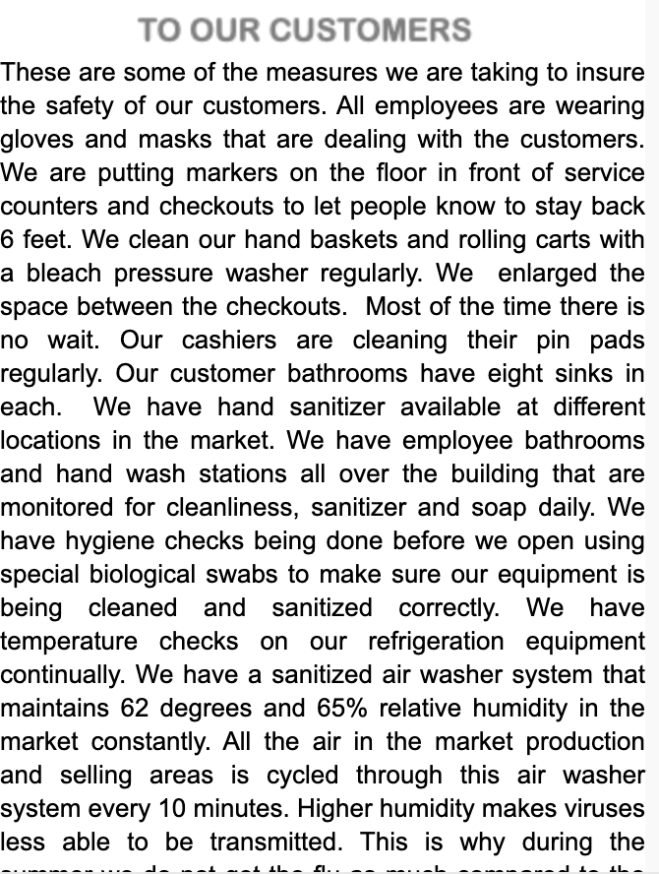
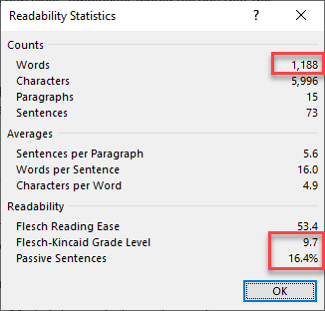
Project Objective - Improve Readability
DFM utilizes large blocks of text throughout the site that is overwhelming for readers.
Sub-objectives:
Pare down content
Highlight history, reputation, sourcing, and current events at DFM
Readability statistics.
Example text block from DFM site. [3]
Notes:
References
[3] Home, www.dekalbfarmersmarket.com/index.html.

Slide 7
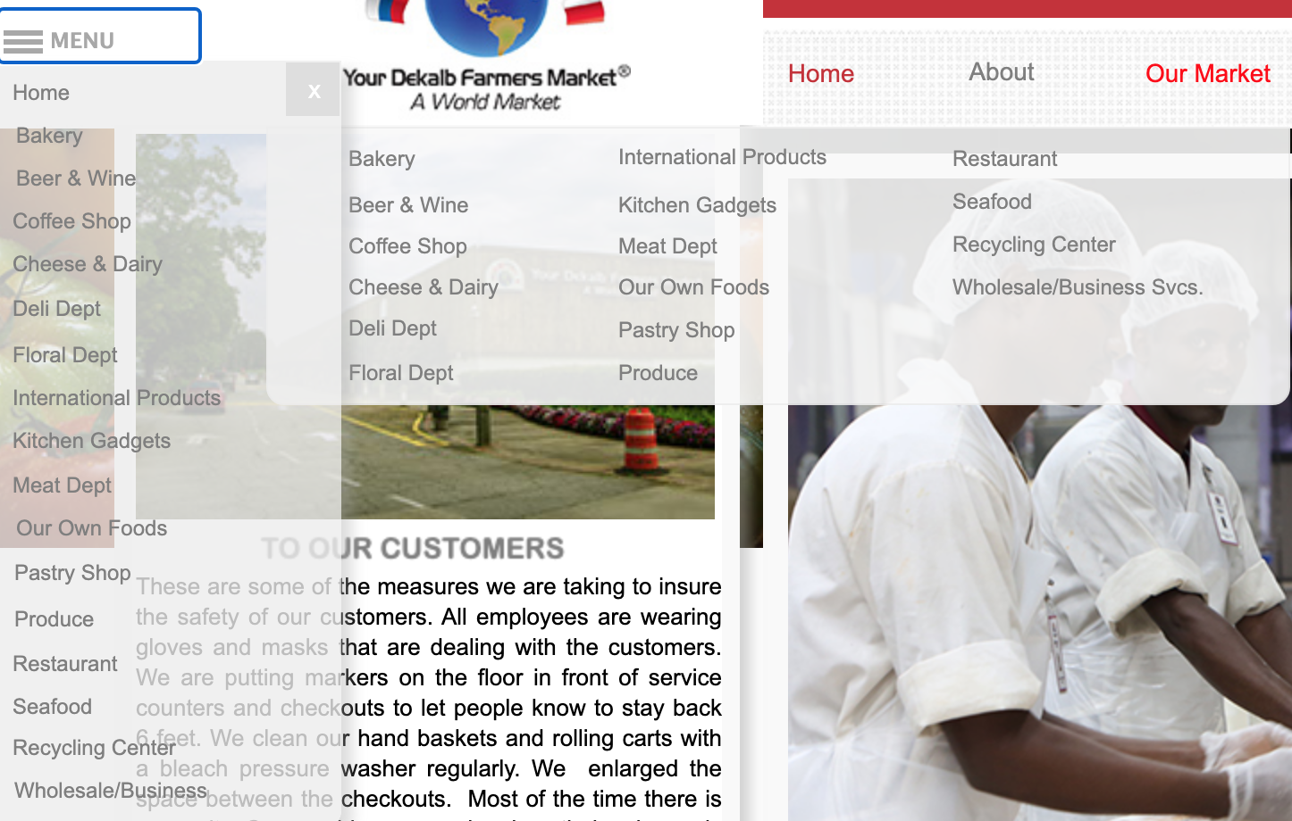
Project Objective - Improve Navigational Structure
Site has multiple menus with overlapping categories.
Sub-objectives:
Simplify navigation menus
Validate through task completion percentages
Expanded menus on DFM site. [3]
Notes:
References
[3] Home, www.dekalbfarmersmarket.com/index.html.

Slide 8
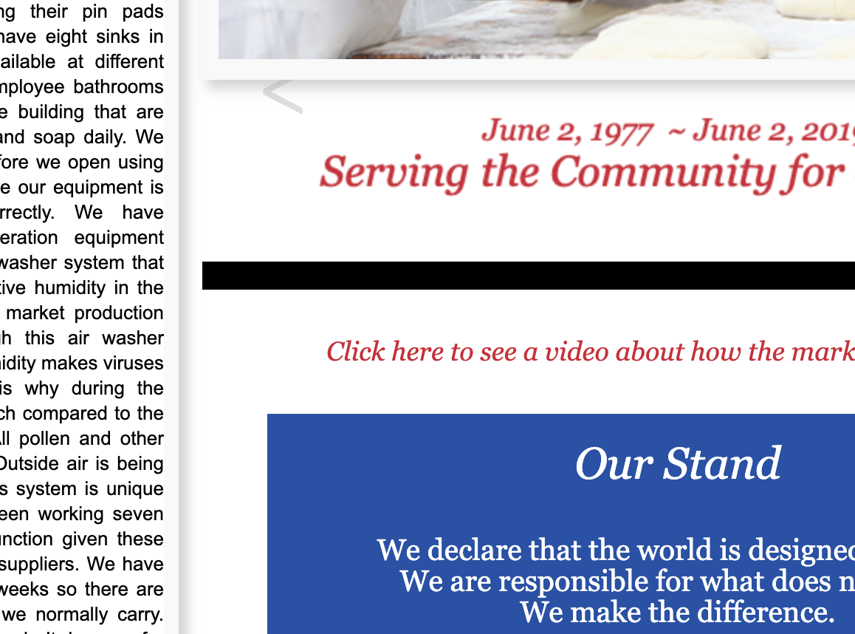
Project Objective - Improve Website Desirability
DFM site has inconsistent color choices and typography.
Sub-objective:
Introduce consistent theme and branding
Screenshot of DFM site showing inconsistent theme. [3]
Notes:
References
[3] Home, www.dekalbfarmersmarket.com/index.html.

Slide 9
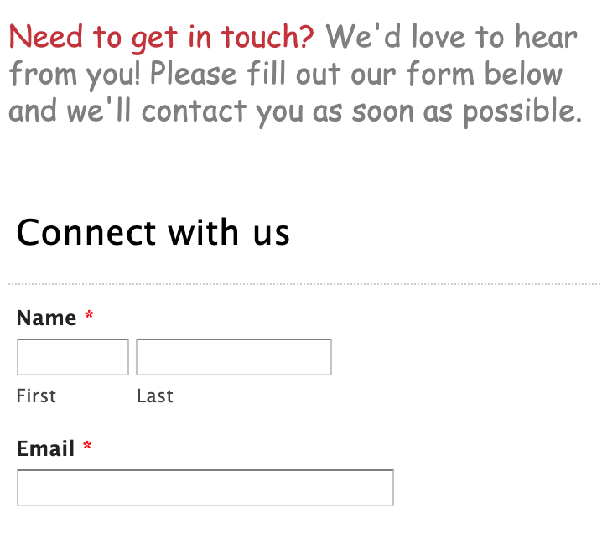
Project Objective - Provide User Safety Net
DFM has contact form and other information dispersed throughout the site.
Sub-objectives:
Incorporate an FAQ page and chatbot
Make customer service information readily available
Contact form on DFM site. [4]
Notes:
References
[4] Connect, www.dekalbfarmersmarket.com/connect.html.

Slide 10
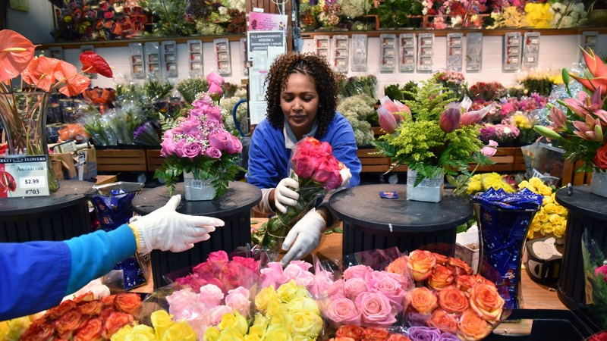
Business Objective - Acquire 20% More Farmers
“Some farmers aren't willing to take a chance on a new market… Our market has been around for 25 years; we have a track record in the community. This is a market where [farmers] know they're going to sell out.” [X]
How will we measure this objective?
Achieved through Project Objective - Improve Readability
Validated through surveying newly acquired sources
Current vendor at DFM. [5]
Notes:
References
[5] Clayvon, Candace. “Photos: A Guide to Your DeKalb Farmers Market.” Ajc, The Atlanta Journal-Constitution, 4 Oct. 2018, www.ajc.com/lifestyles/photos-guide-your-dekalb-farmers-market/KtMULOtw9rd2jWnu2VlYGJ/.

Slide 11
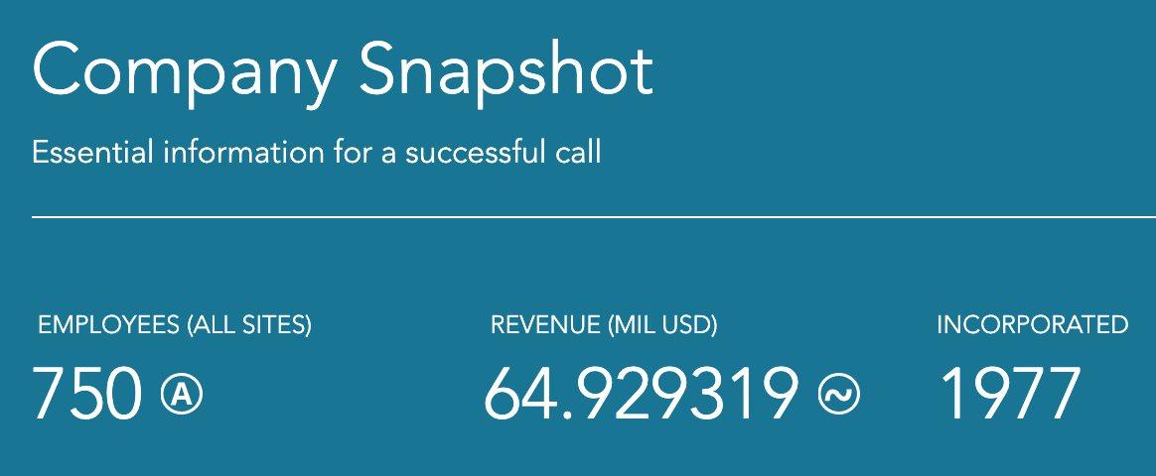
Business Objective - Increase Revenue by 10%
How will we measure this objective?
Achieved by attracting shoppers through updated website
Validated through surveying customers and comparing website activity on current vs. prototyped sites
Current statistics on DFM. [6]
Notes:
References
[6] Dunsford and Bradstreet. “Your DeKalb Farmers Market.”, 2020, www.dnb.com/business-directory/company-profiles.dekalb_farmers_market_inc.d9ef8a41494e40a06e323cb375ab5337.html

Slide 12
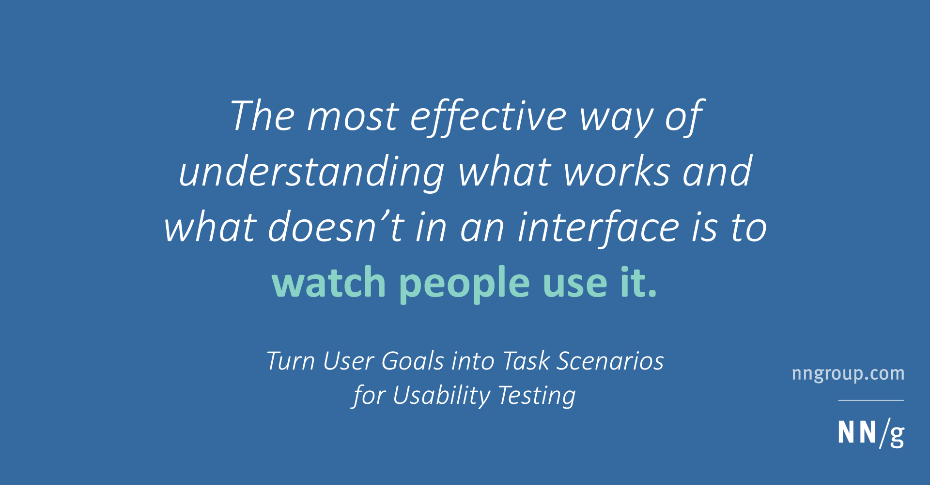
Business Objective - Increase Task Success Percentage by 75%
How will we measure this objective?
Achieved through Project Objectives of Improving Readability and Navigational Structure
Validated through task-based usability testing on current vs. prototyped sites
Usability testing quote. [7]
Notes:
References
[7] World Leaders in Research-Based User Experience. “Task Scenarios for Usability Testing.” Nielsen Norman Group, www.nngroup.com/articles/task-scenarios-usability-testing/.

Slide 13

Barriers to Success
Lack of Marketing
No campaign is currently visible
Minimal social media presence
Research Limitations
Skewed survey data
Pointed tasks in usability tests
COVID-19
Pandemic-driven recession will inevitably lead to decrease in product demand
Difficulty recruiting participants for testing and feedback
Novel coronavirus. [8]
Notes:
References
[8] Haseltine, Opinion by William A. “A Mutation Shows Why the Coronavirus Is Such a Formidable Foe.” CNN, Cable News Network, 13 June 2020, www.cnn.com/2020/06/12/opinions/coronavirus-mutation-increased-infectivity-haseltine/index.html.

Slide 14
Research

Slide 15
Research plan
Heuristic Evaluation
Competitive Analysis
User Survey
Target Audience Generation
User Persona Generation
- Perform a site analysis of the existing DFM website
- Assign scores to certain features in order to measure against competitor sites
- Perform site analyses of competitor and similar sites
- Compare scores of competitor site features to DFM site
- Collect self-reported data on users with different backgrounds and interaction with DFM or other farmers markets
- Scope target audiences based on key differentiators and how they interact with farmers markets websites
- Emphasize audience relationship to project and business objectives
- Define user persona key differentiators based on realistic characteristics and data retrieved from surveys

Slide 16
Heuristic Evaluation
Note - Link to full site review with comments can be found here: Site Review
The existing site was evaluated on the following characteristics (followed by their respective scores):
Brand and Visual Design - 5 out of 18 possible points
Navigation - 4 out of 18 possible points
Content - 4 out of 12 possible points
Usability - 1 out of 3 possible points
Accessibility - 6 out of 15 possible points
Site Review
Market | DeKalb Farmers Market
Website | dekalbfarmersmarket.com/
Website Score | 20
Synopsis of site review showing overall score.

Slide 17
Competitive Analysis
Note - Link to full competitive analysis with comments can be found here: Competitive Analysis
Site Review and Competitive Analysis
Market | DeKalb Farmers Market | Peachtree Road Farmers Market | East Atlanta Village Farmers Market | Morningside Farmers Market
Website | dekalbfarmersmarket.com/ | peachtreeroadfarmersmarket.com/ | cfmatl.org/eav/ | morningsidemarket.com/
Website Score | 20 | 45 | 54 | 47
Synopsis of site review showing overall scores for DFM and competitor sites.
Competitor sites were evaluated against the same metrics as the DFM site
The resulting analyses highlighted areas of improvement and implementation possibilities for the wireframing process

Slide 18
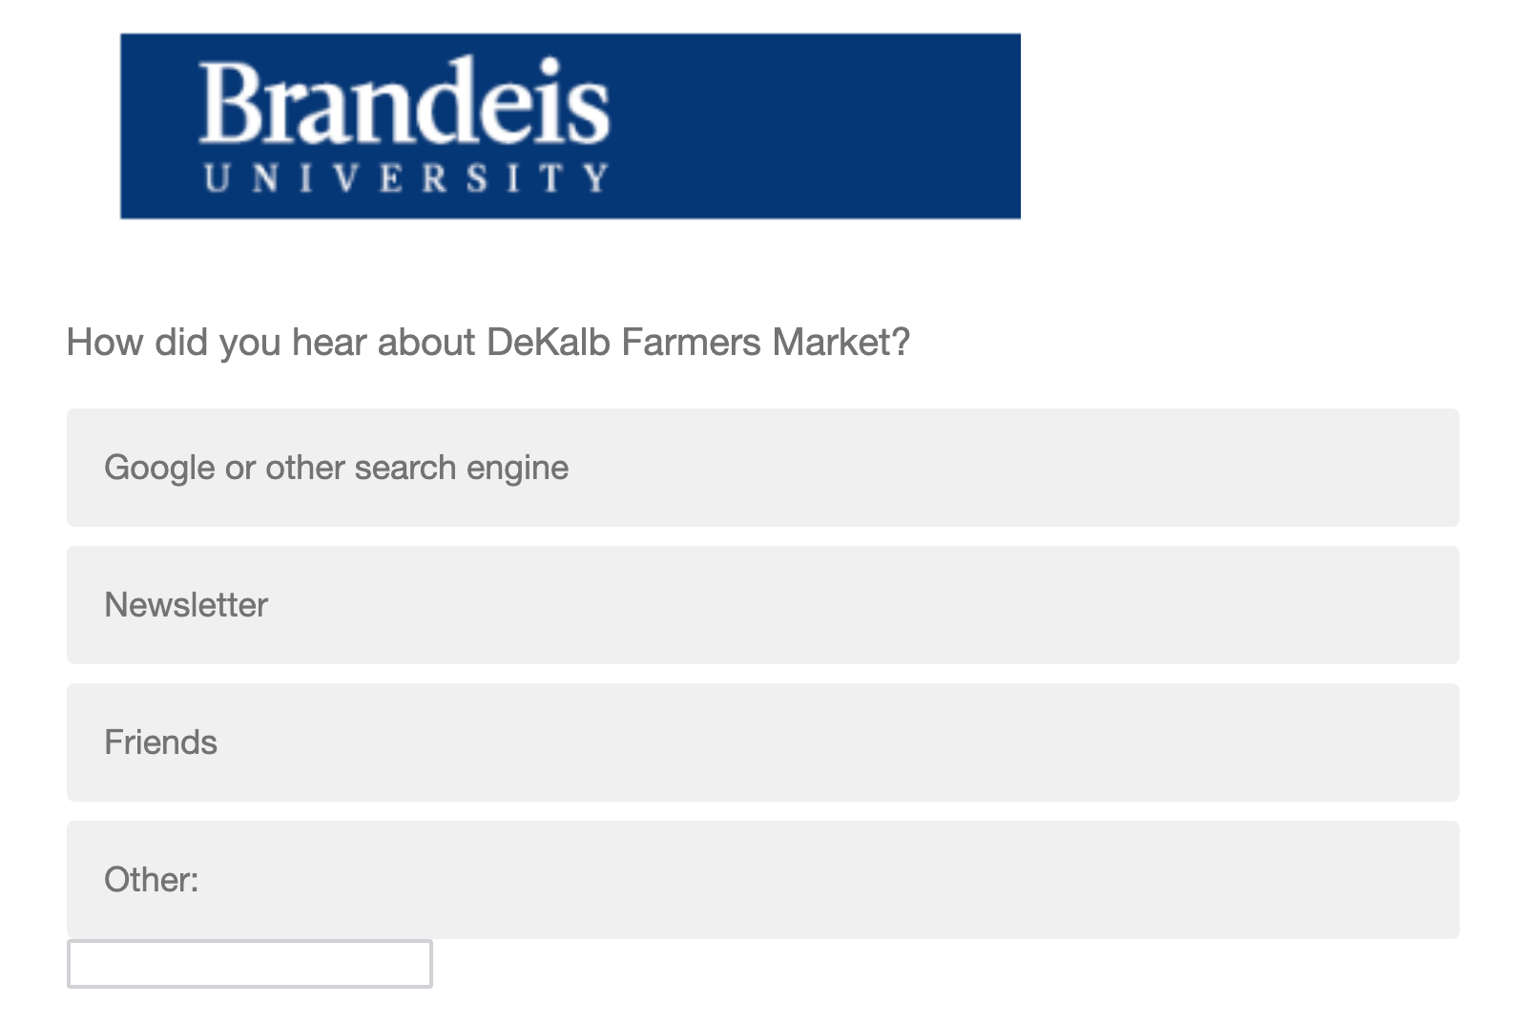
Survey
Note - Link to full survey can be found here: Survey
Qualtrics survey was created to retrieve self-reported user data
Gained insight into:
Types of users
User interactions with DFM and other farmers markets
User perceptions of DFM and other markets
Screenshot showing first question of created survey.

Slide 19
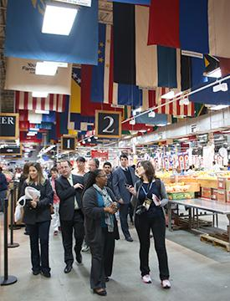
Target Audiences - Prospective Shoppers
Key Differentiators:
Aware of DeKalb
Buy groceries from other stores/farmers markets
Value product quality over price
Shoppers from PMA exploring the market. [9]
Notes:
References
[9] People, www.dekalbfarmersmarket.com/people.html.

Slide 20
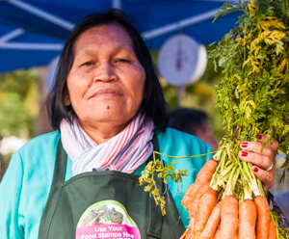
Target Audiences - Prospective Vendors
Key Differentiators:
Interested in selling at DeKalb
Experience with selling at other farmers markets
Primarily concerned with reputations of farmers markets when choosing where to sell
Imagined example of target vendor. [10]
Notes:
References
[10] Isis Madrid. “The Female Farmer Project Chronicles the Rise of Farms Operated by Women.” GOOD, GOOD, 1 Aug. 2019, www.good.is/articles/female-farmer-project-photography-feminism.

Slide 21
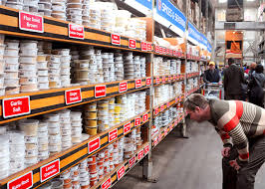
Target Audiences - Current Shoppers
Key Differentiators:
Regularly buy groceries from DeKalb
Rarely interact with website
Interested in learning more about DeKalb offerings
Customer exploring spice options at the market. [3]
Notes:
References
[3] Home, www.dekalbfarmersmarket.com/index.html.

Slide 22
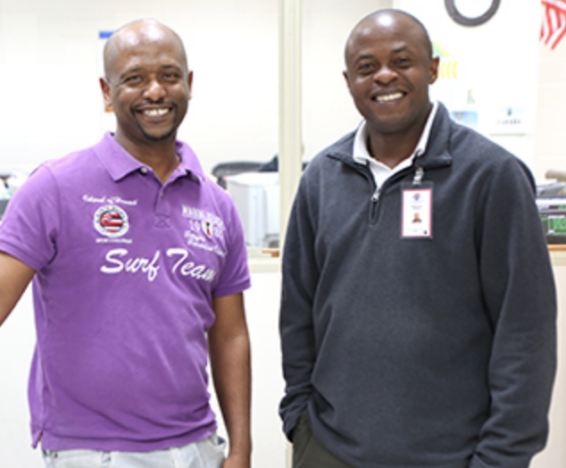
Target Audiences - Job Seekers
Key Differentiators:
Interested in joining staff at DeKalb
Disinterested in other aspects of the market
Seeking career highlights/overview to better understand opportunities
Current DFM employees. [11]
Notes:
References
[11] Careers, www.dekalbfarmersmarket.com/careers.html.

Slide 23
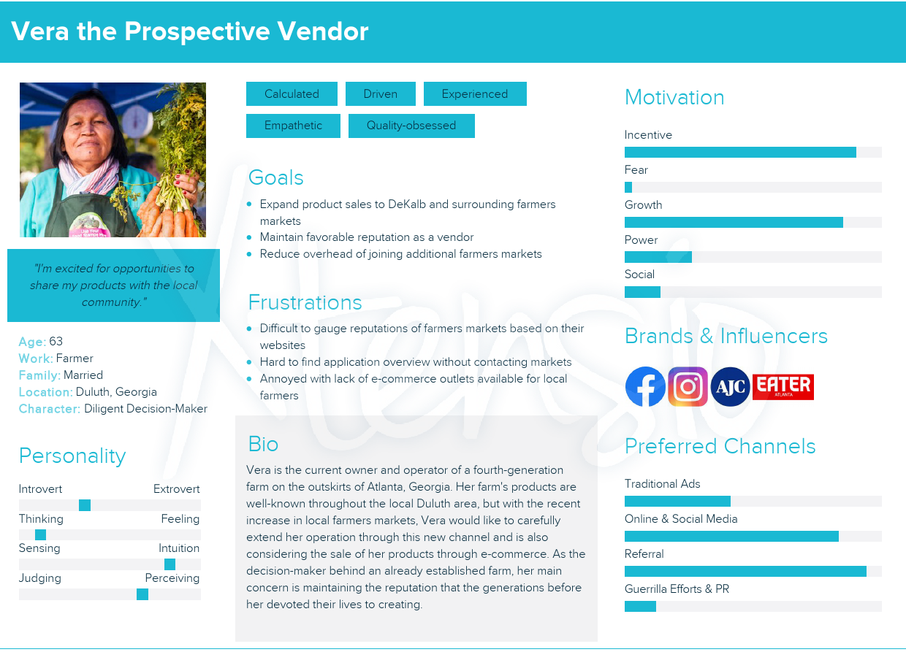
User Persona - Prospective Vendor
Note - Links to full screen user persona can be found here: Persona
Target audiences split among group members
Emphasized concern for reputation and traditional communication
User persona created for prospective vendors.

Slide 24
User Experience Design

Slide 25
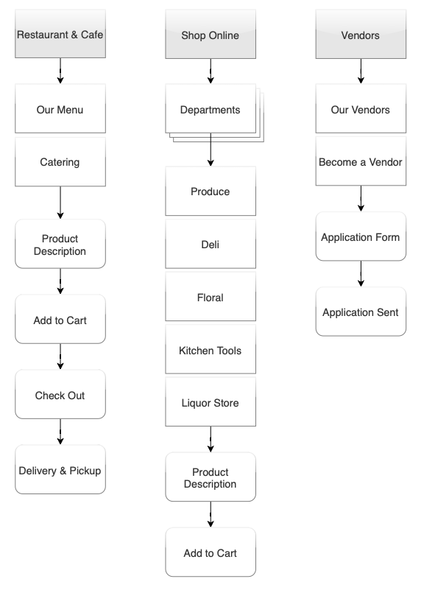
Sitemap
Note - Link to navigation and sitemap proposal can be found here: Navigation and Sitemap
Designed to help achieve Project Objective - Improve Navigational Structure
Proposed sitemap consolidates sections from current DFM site
Focused on assuring users of where to locate information or complete tasks
Example sitemap from proposal..

Slide 26
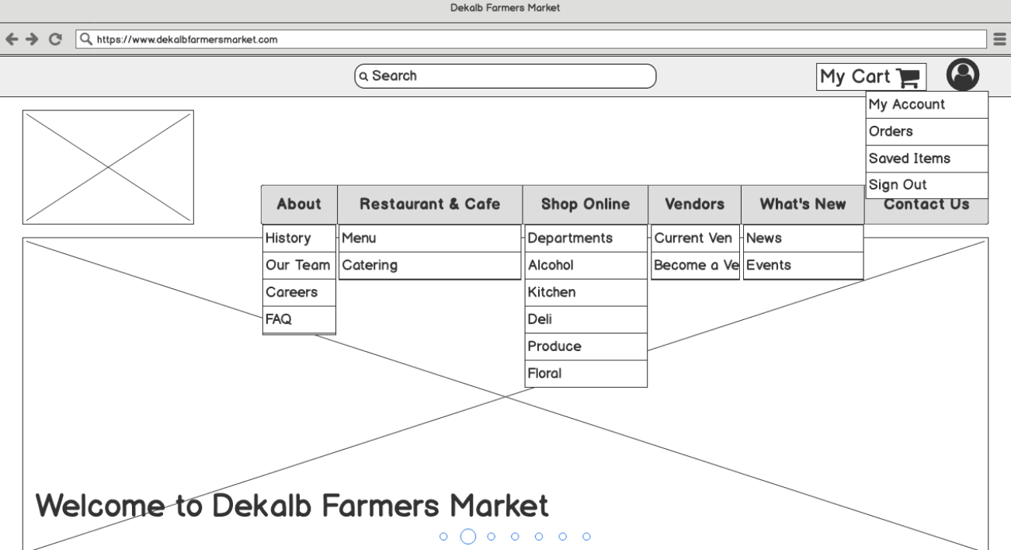
Wireframes: Desktop
Note - Links to full wireframe images can be found here: Homepage Shop Online
Implemented proposed navigation structure
First iteration of paring down content to essential sections
Addressed any visible issues with sitemap prior to usability test
Screenshot showing top-half of homepage.

Slide 27
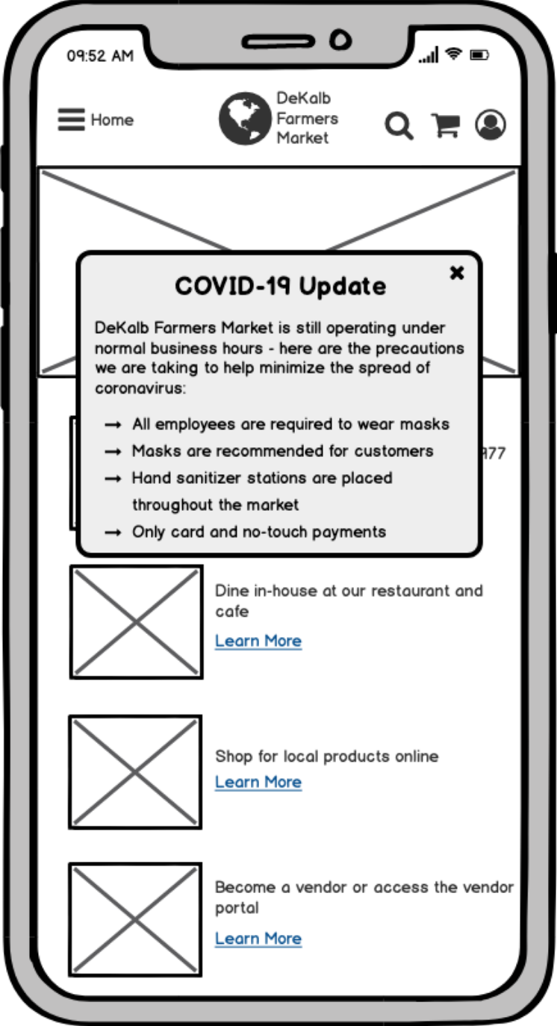
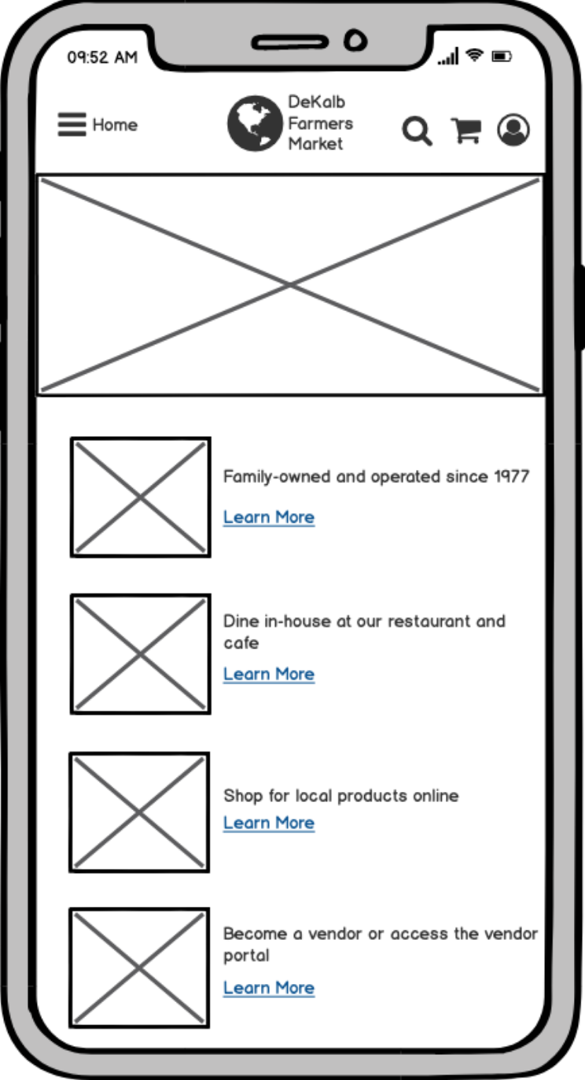
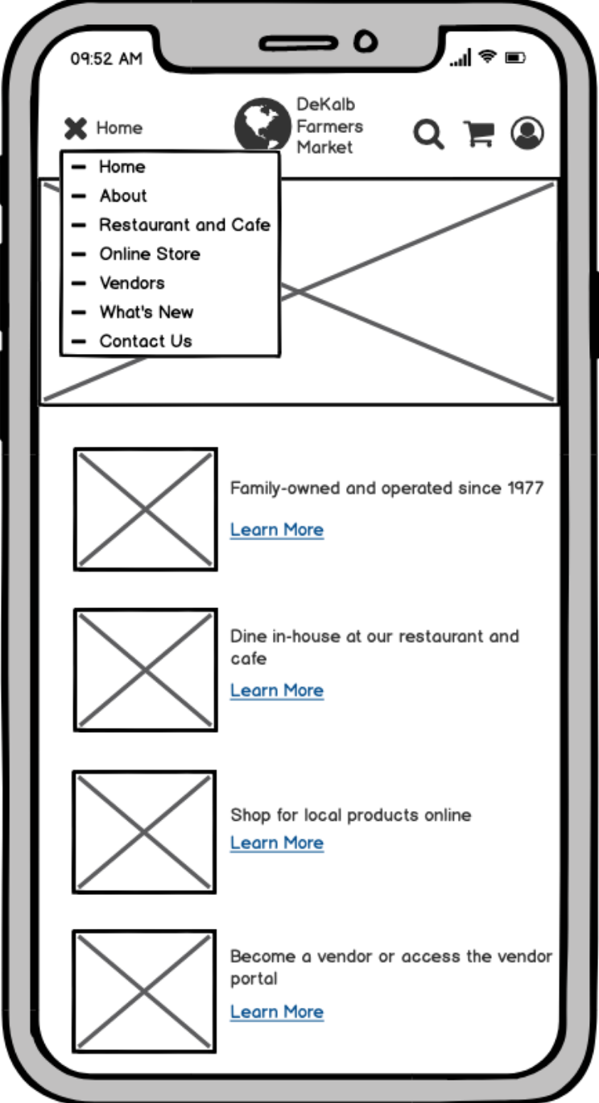
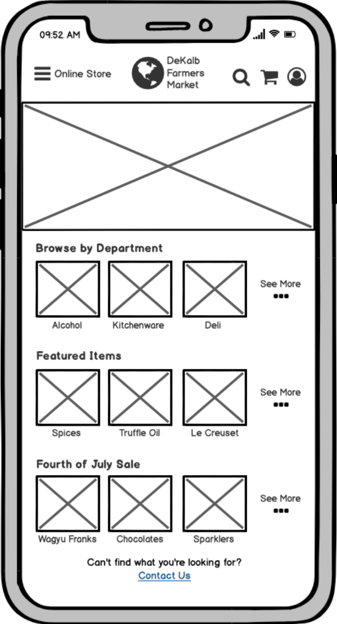
Wireframes: Mobile
Note - Screenshot titles are links to full wireframe images
Homepage with modal
Homepage
Menu expanded
Online Store

Slide 28
Usability Testing

Slide 29
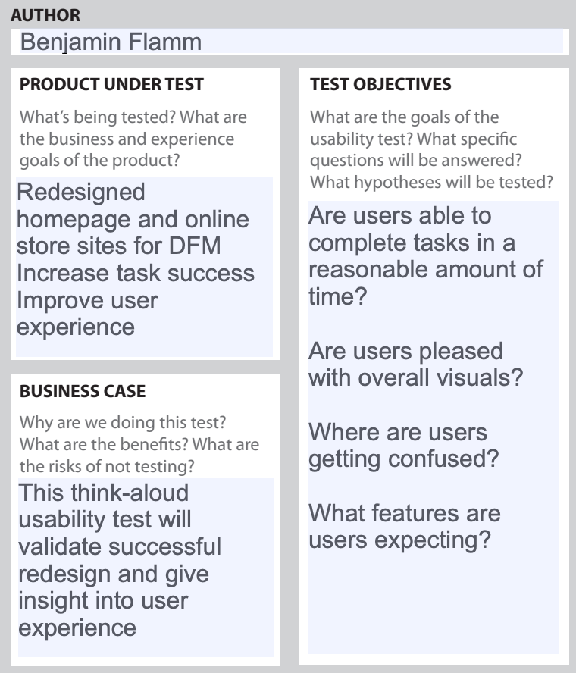
Usability Testing Plan
Note - Links to testing plan and script can be found here: Usability Testing Plan Testing Script
Focused on uncovering issues in the design
The usability testing plan covers logistics of the test:
Participant and environment information
Tasks to be completed
The testing script contains:
Facilitator instructions
Task-based questionnaire to be conducted with participant
Snippet from usability testing plan.

Slide 30
Usability Testing Results
Note - Link to usability test recording can be found here: Usability Test Recording
Test was conducted in Atlanta, GA, on 9 June 2020
High-level task success completion percentage of 100%
Participant expectations met with the exceptions of:
The participant expected the online shopping flow to start with general departments then subsequently narrow down items
The participant expected the Vendors component to be focused on learning about vendor offerings

Slide 31
Conclusions

Slide 32
Unanswered Questions
Business Objectives
What business initiatives does DFM have that our team is unaware of?
There may be marketing or other revenue-driven campaigns that could be useful to integrate with the website redesign.
Solving this would require a conversation with business leads and marketing team.
Explain your answers.

Slide 33
Unanswered Questions
Site Review and Competitive Analysis
Are the features on sites of competing farmers markets what DFM and its users want?
Although other farmers market sites scored higher on the analysis, implementing their features straightaway could lead to further redesign.
Usability tests on competitor sites could prove useful in pruning features that should be avoided in the wireframing process.
Explain your answers.

Slide 34
Unanswered Questions
Target Audiences
Is there a primary target audience for DFM that we missed?
It’s difficult to ensure our team has covered the audiences that DFM is interested in based on its website alone.
By generalizing DFM to other farmers markets, we could have easily missed one.
Needs to be a discussion with DFM stakeholders about potential markets.
Explain your answers.

Slide 35
Unanswered Questions
User Experience Design
What should be the focus of the next design iteration?
Received great feedback from first usability test with ideas of where to proceed.
Need to conduct more tests to see if other users have similar pain points.
By collecting more data, our team can modify the usability tests.
Verify changes that need to be made to the wireframes.
Explain your answers.

Slide 36
DeKalb Farmers Market Buy-In
Does the website influence people to interact with DFM?
Data should be collected throughout the design process to see if people are more or less likely to accomplish their tasks at DFM.
Does it make financial sense to redesign the website of DFM?
Need to prove financial viability of adding an e-commerce component to their site.
Verify they have the staff to develop and maintain website.
Explain your answers.

Slide 37
Lessons Learned
What would you have changed about this process?
I would have begun with user research prior to developing business and project objectives.
With a better understanding of current DFM users, we could have created more pointed and realistic objectives
Explain your answers.

Slide 38
Lessons Learned
What would you have done differently?
Conducted research at DFM and other markets
Because of COVID, user research was limited to internet sources and surveys which would have been complemented with field studies
Designed the desktop and mobile wireframes concurrently
I found myself trying to fill up space in the desktop wireframe that resulted in too much content to be translated to the mobile version.
Explain your answers.

Slide 39
Lessons Learned
What activities would you have taken or deliverables would you have completed if you were running the project on your own?
I would have focused on research and user experience design:
User Surveys
Heuristic Evaluation
Competitive Analysis
Low- and high-fidelity wireframes
Conducting the usability testing
Ideally, the DFM team would focus on forming target audiences, project objectives, and business objectives.
Explain your answers.

Slide 40
Lessons Learned
What people or roles were missing from this project?
DFM marketing team
Multiple assumptions were made about how what audiences DFM is targeting.
DFM business team
Our team constantly returned to the proposed business and project objectives
DFM would have been able to help refine these goals and prevent wasted time on designing low-priority features.
DFM development team
Having developers keeping our design team in check about what is possible
Explain your answers.

Slide 41
Thank you
Benjamin Flamm
bflamm3@brandeis.edu

Slide 42
References
[1] Decaturish.com. “Dear Decaturish – Your DeKalb Farmers Market and the Coronavirus.” Decaturish, 18 May 2020, decaturish.com/2020/05/dear-decaturish-your-dekalb-farmers-market-and-the-coronavirus/.
[2] “Seemingly Endless Fresh Produce beneath the Flags - Picture of Your Dekalb Farmers Market, Decatur.” Tripadvisor, www.tripadvisor.com/LocationPhotoDirectLink-g34895-d1171834-i294438412-Your_Dekalb_Farmers_Market-Decatur_Georgia.html.
[3] Home, www.dekalbfarmersmarket.com/index.html.
[4] Connect, www.dekalbfarmersmarket.com/connect.html.
[5] Clayvon, Candace. “Photos: A Guide to Your DeKalb Farmers Market.” Ajc, The Atlanta Journal-Constitution, 4 Oct. 2018, www.ajc.com/lifestyles/photos-guide-your-dekalb-farmers-market/KtMULOtw9rd2jWnu2VlYGJ/.
Explain your answers.

Slide 43
References Continued
[6] Dunsford and Bradstreet. “Your DeKalb Farmers Market.”, 2020, www.dnb.com/business-directory/company-profiles.dekalb_farmers_market_inc.d9ef8a41494e40a06e323cb375ab5337.html
[7] World Leaders in Research-Based User Experience. “Task Scenarios for Usability Testing.” Nielsen Norman Group, www.nngroup.com/articles/task-scenarios-usability-testing/.
[8] Haseltine, Opinion by William A. “A Mutation Shows Why the Coronavirus Is Such a Formidable Foe.” CNN, Cable News Network, 13 June 2020, www.cnn.com/2020/06/12/opinions/coronavirus-mutation-increased-infectivity-haseltine/index.html.
[9] People, www.dekalbfarmersmarket.com/people.html.
[10] Isis Madrid. “The Female Farmer Project Chronicles the Rise of Farms Operated by Women.” GOOD, GOOD, 1 Aug. 2019, www.good.is/articles/female-farmer-project-photography-feminism.
[11] Careers, www.dekalbfarmersmarket.com/careers.html.
Explain your answers.

